Slide 1

Detecting Malicious URLs Utilizing Machine Learning Classification Models
Presented By: Merry Areej
Supervised By: Ignacio Deza

Slide 2
Research Questions
RQ1: How effective and accurate are machine learning models in determining or predicting the type of a URL?
RQ2: What impact do various URL features have on the performance of machine learning models?
RQ3: Which machine learning model performs the best in terms of detecting the type of a URL?

Slide 3
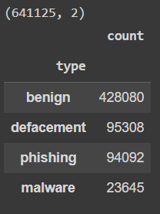
Dataset and Feature Extraction
Sr. No. | Column/Features | Data Type
1 | length of url | Integer
2 | use of ip | Boolean
3 | use of hostname | Boolean
4 | length of hostname | Integer
5 | count of / | Integer
6 | count of // | Integer
7 | length of first directory | Integer
8 | length of top level domain | Integer
9 | count of subdomains | Integer
10 | use of url shortner | Boolean
11 | count of https | Integer
12 | count of http | Integer
13 | count of % | Integer
14 | count of ? | Integer
15 | count of - | Integer
16 | count of = | Integer
17 | count of . | Integer
18 | count of www | Integer
19 | count of @ | Integer
20 | count of # | Integer
21 | count of ! | Integer
22 | count of $ | Integer
23 | count of * | Integer
24 | count of _ | Integer
25 | count of numbers | Integer
26 | count of letters | Integer

Slide 4
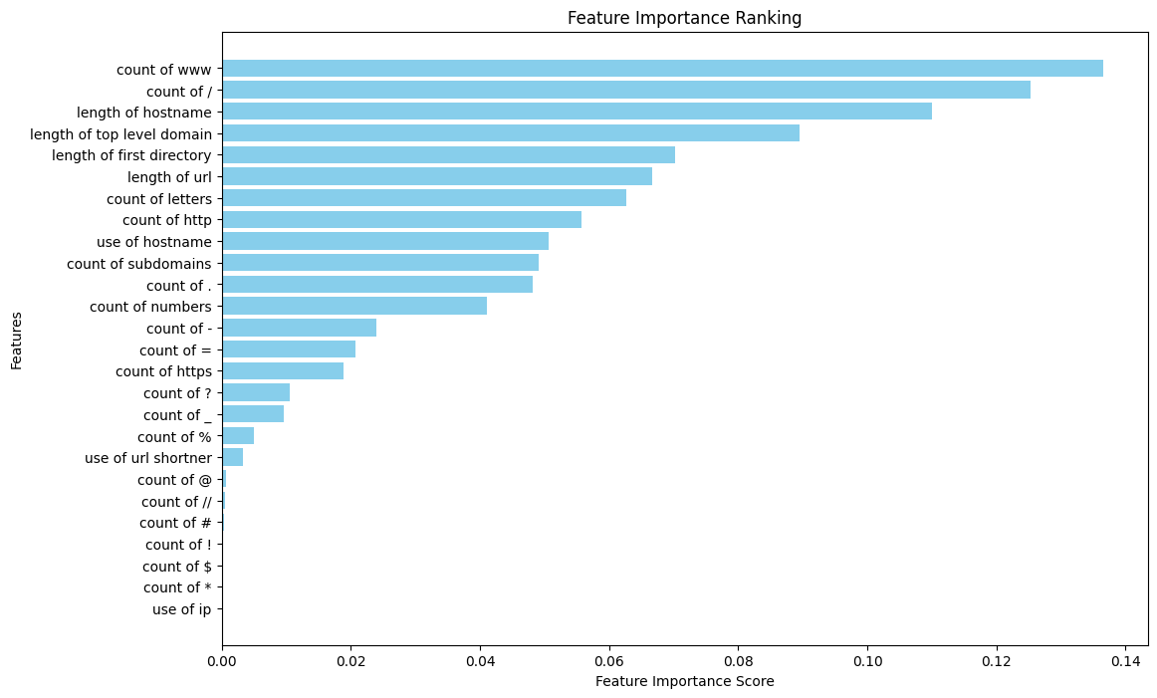
Feature Selection

Slide 5
Deployed Machine Learning Models
Random Forest
Multi-Layer Perceptron
Naïve Bayes

Slide 6
Findings
Cross-Validation Scores
Models | Average Accuracy | Average Precision | Average Recall | Average F1-Score
Random Forest | 95.5% | 95.4% | 95.5% | 95.4%
Multi-Layer Perceptron | 93.9% | 93.7% | 93.9% | 93.7%
Naïve Bayes | 79.6% | 79.8% | 79.6% | 77.7%
Random Forest Performed the best.
Highest average cross-validation scores
Highest classification accuracy
Highest number of true positives
Final Classification Scores on Test Set
Models | Average Accuracy | Average Precision | Average Recall | Average F1-Score
Random Forest | 95.7% | 95.6% | 95.7% | 95.6%
Multi-Layer Perceptron | 93.6% | 93.5% | 93.6% | 93.5%
Naïve Bayes | 79.5% | 79.6% | 79.5% | 77.6%

Slide 7
Demonstration

